Slide 1
Python Data Structures
By Greg Felber

Slide 2
Lists
An ordered group of items
Does not need to be the same type
  Could put numbers, strings or donkeys in the same list
List notation
  A = [1,”This is a list”, c, Donkey(“kong”)]

Slide 3
Methods of Lists
List.append(x)
  adds an item to the end of the list
List.extend(L)
  Extend the list by appending all in the given list L
List.insert(I,x)
  Inserts an item at index I
List.remove(x)
  Removes the first item from the list whose value is x

Slide 4
Examples of other methods
a = [66.25, 333, 333, 1, 1234.5] //Defines List
  print a.count(333), a.count(66.25), a.count('x') //calls method
  2 1 0 //output
a.index(333)
  //Returns the first index where the given value appears
  1 //ouput
a.reverse() //Reverses order of list
  a //Prints list a
  [333, 1234.5, 1, 333, -1, 66.25] //Ouput
a.sort()
  a //Prints list a
  [-1, 1, 66.25, 333, 333, 1234.5] //Output

Slide 5

Using Lists as Stacks
The last element added is the first element retrieved
To add an item to the stack,
append() must be used
  stack = [3, 4, 5]
  stack.append(6)
  Stack is now [3, 4, 5, 6]
To retrieve an item from the top of the stack, pop must be used
  Stack.pop()
  6 is output
  Stack is now [3, 4, 5] again

Slide 6

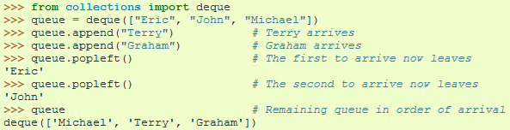
Using Lists as Queues
First element added is the first element retrieved
To do this collections.deque
must be implemented

Slide 7

List Programming Tools
Filter(function, sequence)
  Returns a sequence consisting of the items from the sequence for which function(item) is true
  Computes primes up to 25

Slide 8

Map Function
Map(function, sequence)
  Calls function(item) for each of the sequence’s items
  Computes the cube for the range of 1 to 11

Slide 9

Reduce Function
Reduce(function, sequence)
  Returns a single value constructed by calling the binary function (function)
  Computes the sum of the numbers 1 to 10

Slide 10
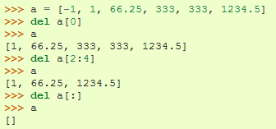
The del statement
A specific index or range can be deleted

Slide 11
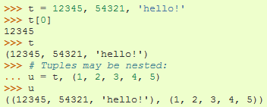
Tuples
Tuple
  A number of values separated by commas
  Immutable
    Cannot assign values to individual items of a tuple
    However tuples can contain mutable objects such as lists
  Single items must be defined using a comma
    Singleton = ‘hello’,

Slide 12
Sets
An unordered collection with no duplicate elements
Basket = [‘apple’, ‘orange’, ‘apple’, ‘pear’]
Fruit = set(basket)
Fruit
  Set([‘orange’, ‘apple’, ‘pear’])

Slide 13
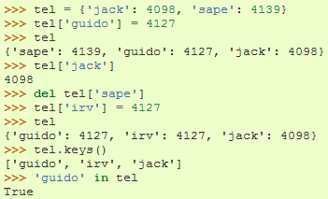
Dictionaries
Indexed by keys
  This can be any immutable type (strings, numbers…)
  Tuples can be used if they contain only immutable objects

Slide 14

Looping Techniques
Iteritems():
  for retrieving key and values through a dictionary

Slide 15

Looping Techniques
Enumerate():
  for the position index and values in a sequence

Slide 16
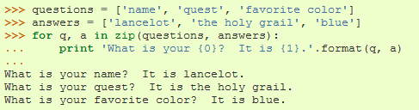
Zip():
  for looping over two or more sequences

Slide 17
Comparisons
Operators “in” and “not in” can be used to see if an item exists in a sequence
Comparisons can be chained
  a < b == c
    This tests whether a is less than b and that b equals c

